Slide 1
Targeted Marketing using Data Mining: Modeling Women's Health Care Decisions
PRAKKAS THULASITHAS
SHASHANK NAIK
SHASHANK SINGHAL

Slide 2
Business Case
Planned Parenthood, the largest U.S. provider of women’s health services wants to launch a new marketing campaign
Target: women who are most likely to enroll in a birth control counselling service in the next 6 months.
2 Marketing strategies
M1: $15 / person
M2: $7 / person
Benefit:
If response: $ 50
if not: $ 0

Slide 3
Data Understanding
Public dataset - DrivenData.org, NSFG, CDC
> 1k features: Demographics, residence, work history, marital and relationship history, past operations ….
Features data type: categorical, numeric, ordinal
> 14k instances of patients

Slide 4
Data Preparation
Training set values: 1379 features and 14644 data instances. Of this we took 4000 as Out of Sample data instances
Training set labels: These are the labels that we build a model on to predict. The instances are mapped to the labels (service target variables). We selected one of the targets for our purpose (service A - Counselling for birth control and safe sex measures).
Test set values: There are 4000 unlabeled data instances.

Slide 5
Data Preparation
Imported the CSV into Weka, converted Ordinals to Categorical using NumericToNominal.
Corrected the Target label to Categorical.
Removed attributes with more than 90% missing values and same value all through.
Downscaled the number of attributes to 1177 based on InfoGainAttributeEval in Weka.
Issues with the originally provided test set because of differences in the attribute ranges, and our type conversions.
Split the training data to get labelled Test set. We kept 10644 data instances for our in sample training data set and the rest 4000 were kept as out of sample.
Training Set and Out of Sample Test Set have baserate of about 47%

Slide 6
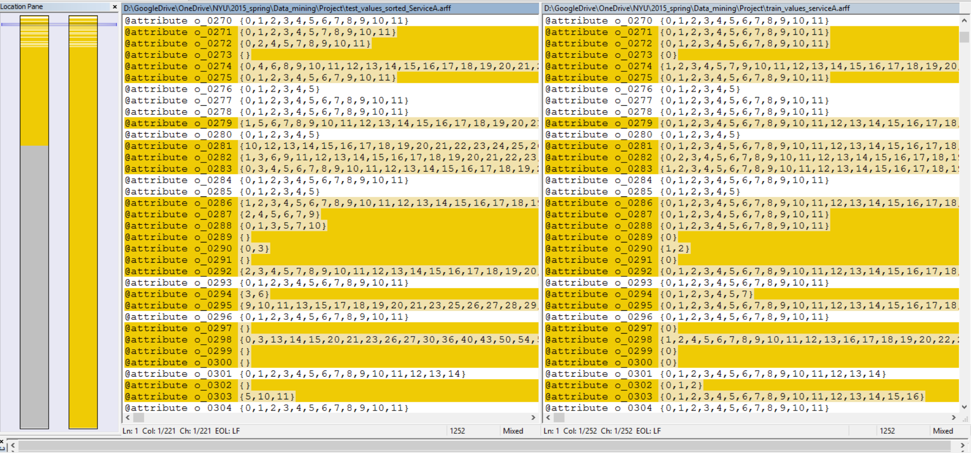
Data Preparation (File incompatibility)

Slide 7
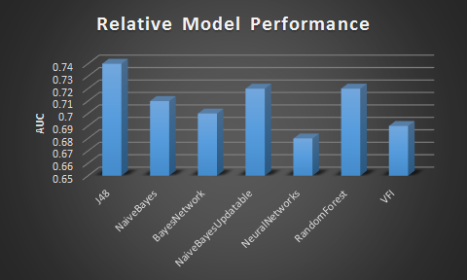
Modelling
J48
NaiveBayes
BayesNetwork
NaiveBayesUpdatable
NeuralNetworks
RandomForest
VFI (Voting Feature Intervals)
Others: ADT, Logistic Regression, SVM

Slide 8
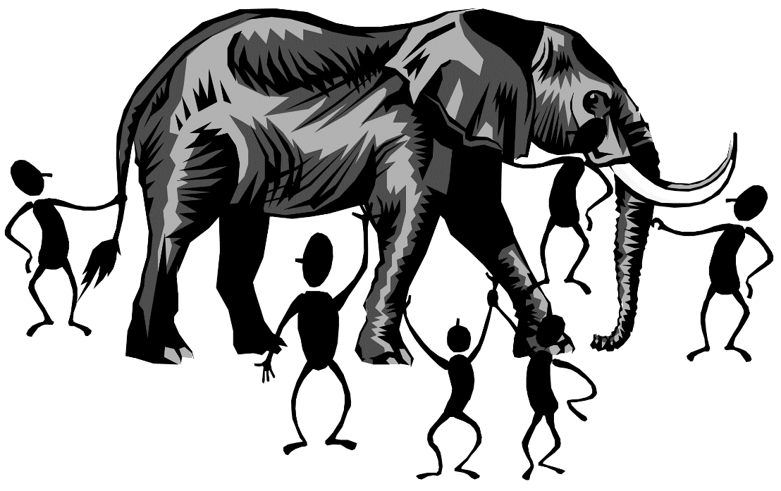
Issue: Causation or Data Leakage?
While running our model, we encountered something unexpected.
One attribute gave unusually high InfoGain
Predictions modelled on that single attribute gave results just as well as the entire data set! (AUC almost 0.9)
Causation or Data leakage? We contacted the data provider for the attribute labels to try and figure it out.

Slide 9

Data Leakage!
Data Leakage is the creation of unexpected additional information in the training data, allowing a model or machine learning algorithm to make unrealistically good predictions.
C_1259 -> Most recent contraceptive method prescribed.
Target -> Counselling for Birth Control or Prescription.
Removed the attribute to plug the leak. (AUC 0.74)
Significance of attribute selection, even without domain knowledge.

Slide 10
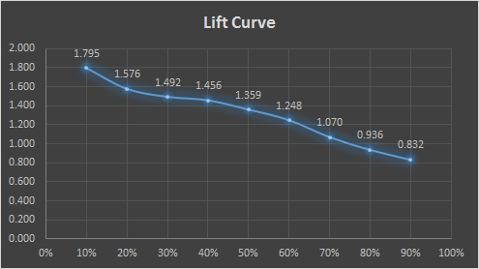
Evaluation

Slide 11
Business Decision
Two Marketing offers: M1 and M2, with cost : C(M1) > C(M2)
Based on the results of the model, we rank the customers on the probabilities of them using the service
Customers above a high cutoff of (0.8) are very likely to use the service and Customers between 0.5-0.8 are moderately likely to be interested in using the service
We analyze the effects of the two marketing strategies and try to maximize the profit.

Slide 12
Business Decision
P(M1) = The probability of a person converting after being offered Strategy 1
P(M2) = The probability of a person converting after being offered Strategy 2
P(H) = Probability of a person to use the service > 0.8
P(L) = Probability of a person to use the service > 0.5 and <0.8

Slide 13
Business Decision
Assuming a case with M1 for H and M2 for L:
[Total Cost M1 + Total Cost M2] = n (H) x C1 + n (L) x C2
Revenue = [P(M1/H) x n(H) + P(M2/L) x n(L)] x (Cost of service)
Profit = Revenue - Costs

Slide 14
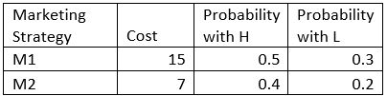
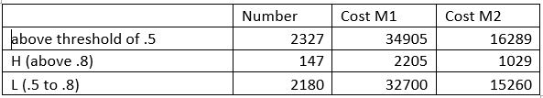
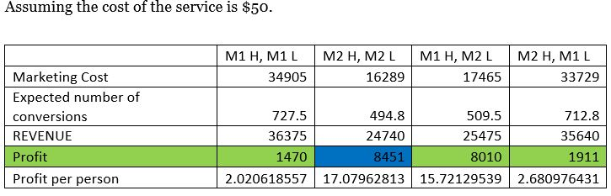
The Results! (Well predicted Results)

Slide 15

Deployment
Use predictions to decide target and market to them
Track if customer responds within next 6 months
Update performance of marketing strategy and estimated benefits from a new customer
Re evaluate which marketing strategy yields highest profit

Slide 16

Ethical Dilemma
Using public data to market to targeted people as company has advantage of access.
Needs to set limit how this data is used.
Company’s responsibility to decide the fine line between helping and intruding personal lives

Slide 17

Thank You!
Questions?

